Slide 1
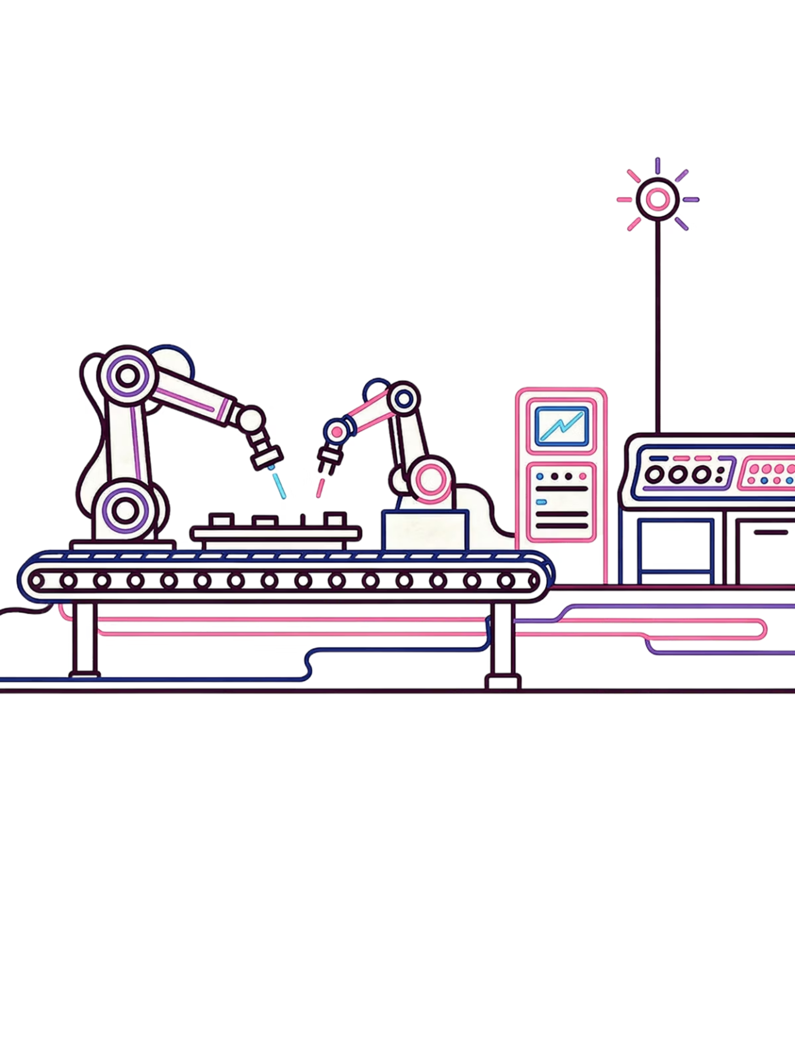
Edge Computing in Industrial Communication
Edge computing processes data near where it is created — at machines, sensors, and cameras — instead of sending everything to a far cloud server. Only important results are sent to the cloud. This makes response times very fast, which is critical for factories and industrial systems.
Low Latency
Data is processed locally, so systems can react in milliseconds. Cloud systems can take over 500 ms.
Reduced Bandwidth
Only filtered, useful data is sent to the cloud. Raw data stays local.
Resilience
If the cloud connection drops, the edge system keeps working on its own.
Privacy & Security
Sensitive data never leaves the factory. It is processed and stored locally.

Slide 2
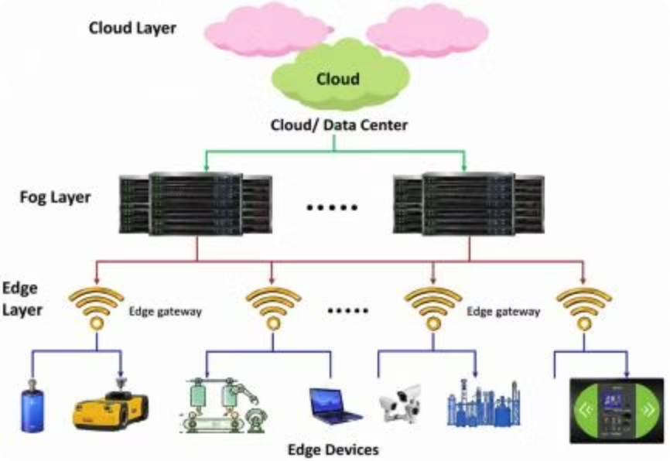


Architecture of Edge Computing
The architecture works like a chain — starting from physical machines at the bottom and ending at the remote cloud at the top. Each layer has a specific job. Data is processed at the right place and speed.
Edge Layer
Fog Layer
Collects raw data from machines and processes it locally — nothing needs to go to a remote server. Also acts as a translator between different protocols like MODBUS and OPC-UA. Can run AI to detect problems in real time.
Sits between the edge and the cloud. Buffers and short-term stores data from edge gateways so the cloud connection does not get overloaded.
Cloud Layer
Edge Gateway Server
Handles tasks that are not time-critical: long-term storage, retraining AI models, ERP/MES reporting, and global monitoring. Only receives pre-filtered data.
Acts as the entry point to the industrial edge network. Translates protocols, filters raw data, and secures traffic between the factory and outside networks.
Key Components: Edge Devices (sensors, cameras, PLCs, IoT modules) collect raw data. Edge Nodes (routers and switches) process data locally and decide what goes to the cloud. Edge Data Centers are small local data centers near the factory. Edge Analytics runs AI/ML on edge nodes to detect faults in real time. Connectivity uses industrial Ethernet, 5G, or private wireless networks.

Slide 3
Edge vs. Cloud: Comparison & Test Results
Comparison Table
Feature
Cloud Computing
Edge Computing
Processing location
Central cloud server
Near the device
Latency
Higher
Lower
Bandwidth use
More data sent to cloud
Less data sent to cloud
Storage capacity
Very high
Limited
Offline operation
No
Yes
Best use
Big data storage & analysis
Real-time applications

